Slide 1
q2 2017 rEPORT TO CITY Council
August 8, 2017

Slide 2
Four core service areas
Advance longmont
Advance primary industry
Advance local business
Advance startup community

Slide 3
Q2 2017 MILESTONES
Represented Longmont and Metro Denver at SPACE SYMPOSIUM in Colorado Springs.
Planned and executed SMALL BUSINESS WEEK activities, including a MAYORAL PROCLAMATION designating the first week in May as SMALL BUSINESS WEEK.
Hosted annual CORNERSTONE GALA recognizing companies from all sectors of the local economy for their contributions to job creation and investment in Longmont.
Represented Longmont CLEAN-TECH industry capabilities at NREL INDUSTRY GROWTH FORUM.
Represented Longmont at NOCOM 2017, Longmont’s premier manufacturing trade show.
Partnered with OEDIT to represent Longmont and Colorado at SELECTUSA FDI SUMMIT in Washingthon, D.C.
Participated in the ECONOMIC DEVELOPMENT COUNCIL OF COLORADO – NORTHERN COLORADO REGIONAL FORUM in Loveland.
Completed 2017 ELEVATE SURVEYS for both primary industry and local business.

Slide 4
2017 MARKETING
EVENTS & VISITS
WHERE WE’VE BEEN
OUT-BOUND MARKETING EVENTS
Minneapolis, MN:
Site Selector Meetings – February
LONGMONT
Washington, D.C.:
SelectUSA
Colorado Springs, CO:
Space Symposium
Denver, CO:
NREL Growth Forum
Loveland, CO:
NOCOM 2017
Tampa, FL:
Startup Champions Network Conference - February

Slide 5
2017 MARKETING
EVENTS & VISITS

Slide 6
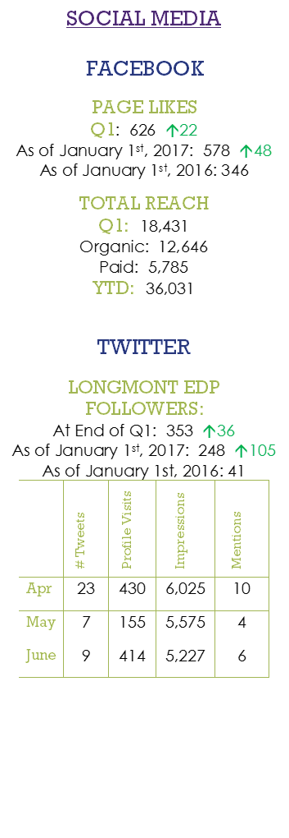
Q2 2017
MARKETING UPDATE

Slide 7
Q2 2017
BY THE NUMBERS
 | Advanced Technology | Bioscience | Creative Arts & Culinary | Prof. Services & IT | Total All Industries
Q4 2016 Jobs | 1,937 | 227 | 5,934 | 4,727 | 12,825
Q1 2017 Jobs | 1,949 | 233 | 5,946 | 4,752 | 12,880
Net Gain/Loss | 12 | 6 | 12 | 25 | 55
% Gain/Loss | .006% | .026% | .002% | .005% | .004%

Slide 8
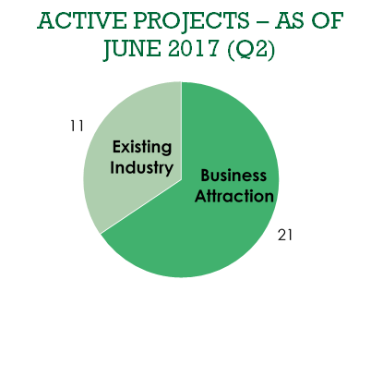
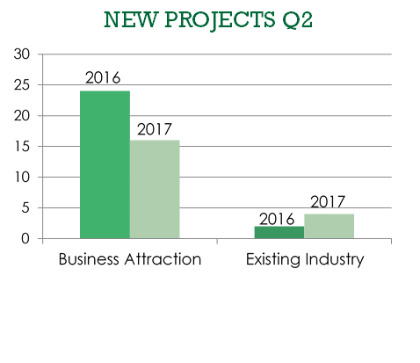
Q2 2017
PROJECT PIPELINE

Slide 9
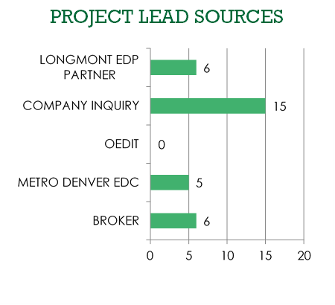
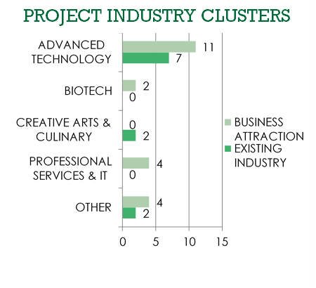
Q2 2017
PROJECT PIPELINE

Slide 10
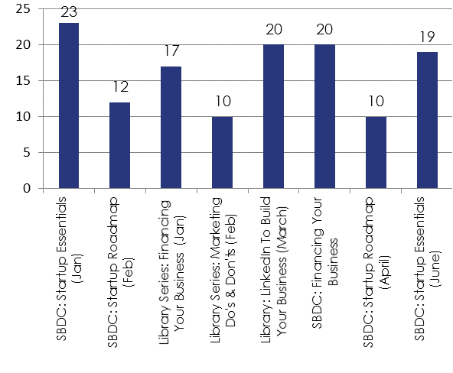
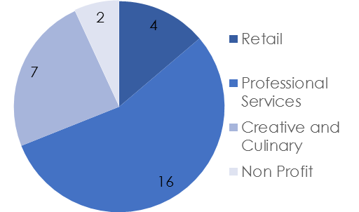
Q2 2017
BY THE NUMBERS
29
MEETINGS WITH LOCAL BUSINESSES REPRESENTING 130 FT JOBS &
46 PT JOBS
5 WORKSHOPS
Total Attendees 131,
Avg. per Class 16

Slide 11
Q2 2017
BY THE NUMBERS
$1,000
IN SCHALLERT GROUP DESTINATION: BOOTCAMP SCHOLARSHIP AWARDED TO:
GEORGIA BOYS
337
HOURS OF SBDC
CONSULTING
77
TOTAL LONGMONT BUSINESSES
RECEIVING SBDC
CONSULTING
$225,875
IN A SMALL BUSINESS LOAN 6 Jobs Retained, 15 Jobs Created

Slide 12
 | # OF SIGN-UPS | TOTAL # OF SESSIONS | AVG. SIGN-UPS PER SESSION
2015 | 1,812 | 52 | 35
2016 | 1,979 | 79 | 25
2017 | 3,607 | 74 | 49
IN-KIND SPONSORS
Circle Graphics * StickerGiant * Avocet Communication *Times Call* Verve Intergrative* Lifelicious* Wyatt’s Wet Goods*Nextlight* CoSolve Coworking* Print Experts* BBP * Jupiter Visual* Ozo Coffee* The Roost* Samples World Bistro*
$17,000 IN FINANCIAL SPONSORSHIPS
Longmont EDP * Terrapin Care Station * Galvanize* UCHealth*CoBiz Bank * City of Longmont * Sunflower Bank* Brewer Law

Slide 13
30
HEADLINES IN REGIONAL PUBLICATIONS
7.17
AVG. # OF SESSIONS ATTENDEES SIGNED UP FOR
$19,241
VALUE OF EARNED MEDIA
9.3
AVERAGE SESSION RATING (SCALE OF 10)

Slide 14
QUESTIONS?

