Slide 1
City of Longmont debt may be increased $22,000,000 with a repayment cost of $40,500,000, to acquire, improve and maintain open space for purposes identified in this ordinance.
Open Space Acquisitions
Open Space, a Historical Perspective
Open Space Properties
Harper
Double 6 Ranch LLC
Newby Farm LLC
Criteria Matrix
Survey Results
Questions and Direction

Slide 2
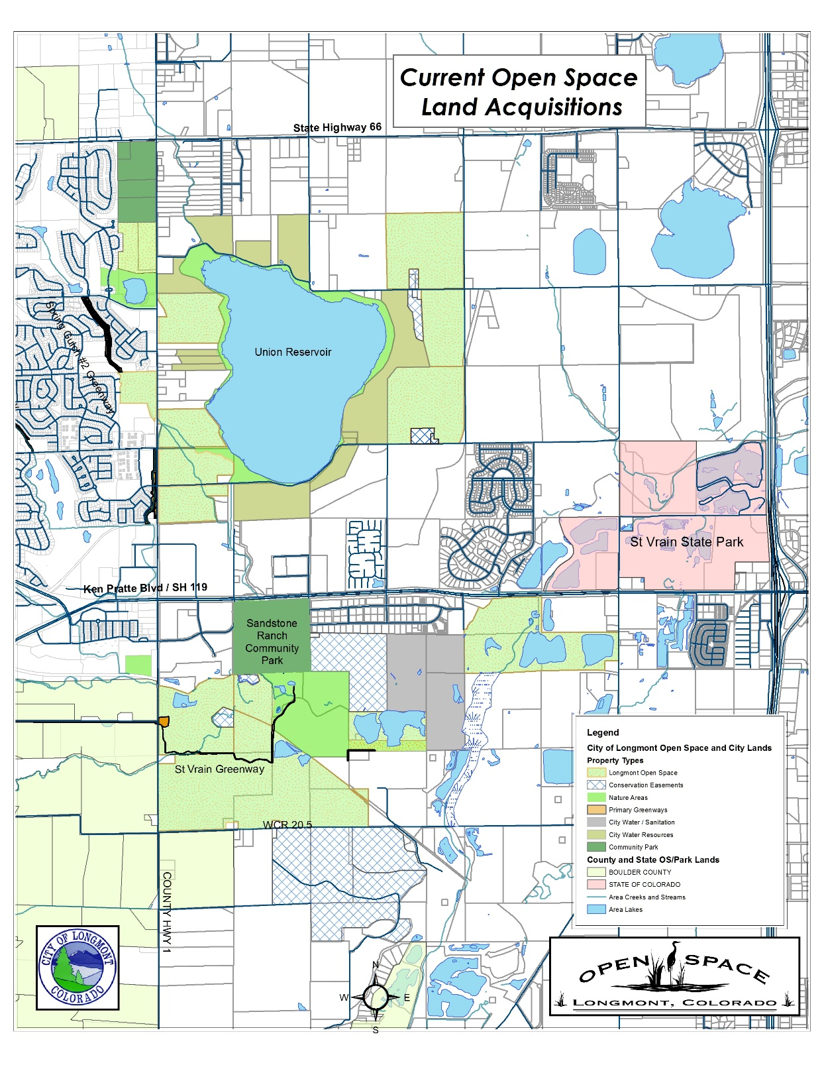
City of Longmont debt may be increased $22,000,000 with a repayment cost of $40,500,000, to acquire, improve and maintain open space for purposes identified in this ordinance.
Current City of Longmont Open Space History
November of 2000
Citizens of Longmont approved .2-cent sales and use tax
Last for 20 years, for the acquisition, improvement and the maintenance of Open Space
To allow issuance of up to $22,000,000 with a repayment of $40,500,000
November 2007
Open Space tax extended from 2020 to 2034
Included revenue bonds in an amount not to exceed $31,000,000
Total repayment cost not to exceed $59,500,000 and an annual repayment cost not to exceed $2,850,000.

Slide 3
City of Longmont debt may be increased $22,000,000 with a repayment cost of $40,500,000, to acquire, improve and maintain open space for purposes identified in this ordinance.
History of 2007 Bonding Authority
In 2010 City issued $15.5 M leaving the City the authority of issuing the remaining balance; $15.5 M
Open Space Sale Tax Fund Acquisitions since 2000
1638 Acres in Fee
1226 Acres of Conservation Easements
Totaling 2,864 acres
Expenditures of approximately $28,166,000

Slide 4
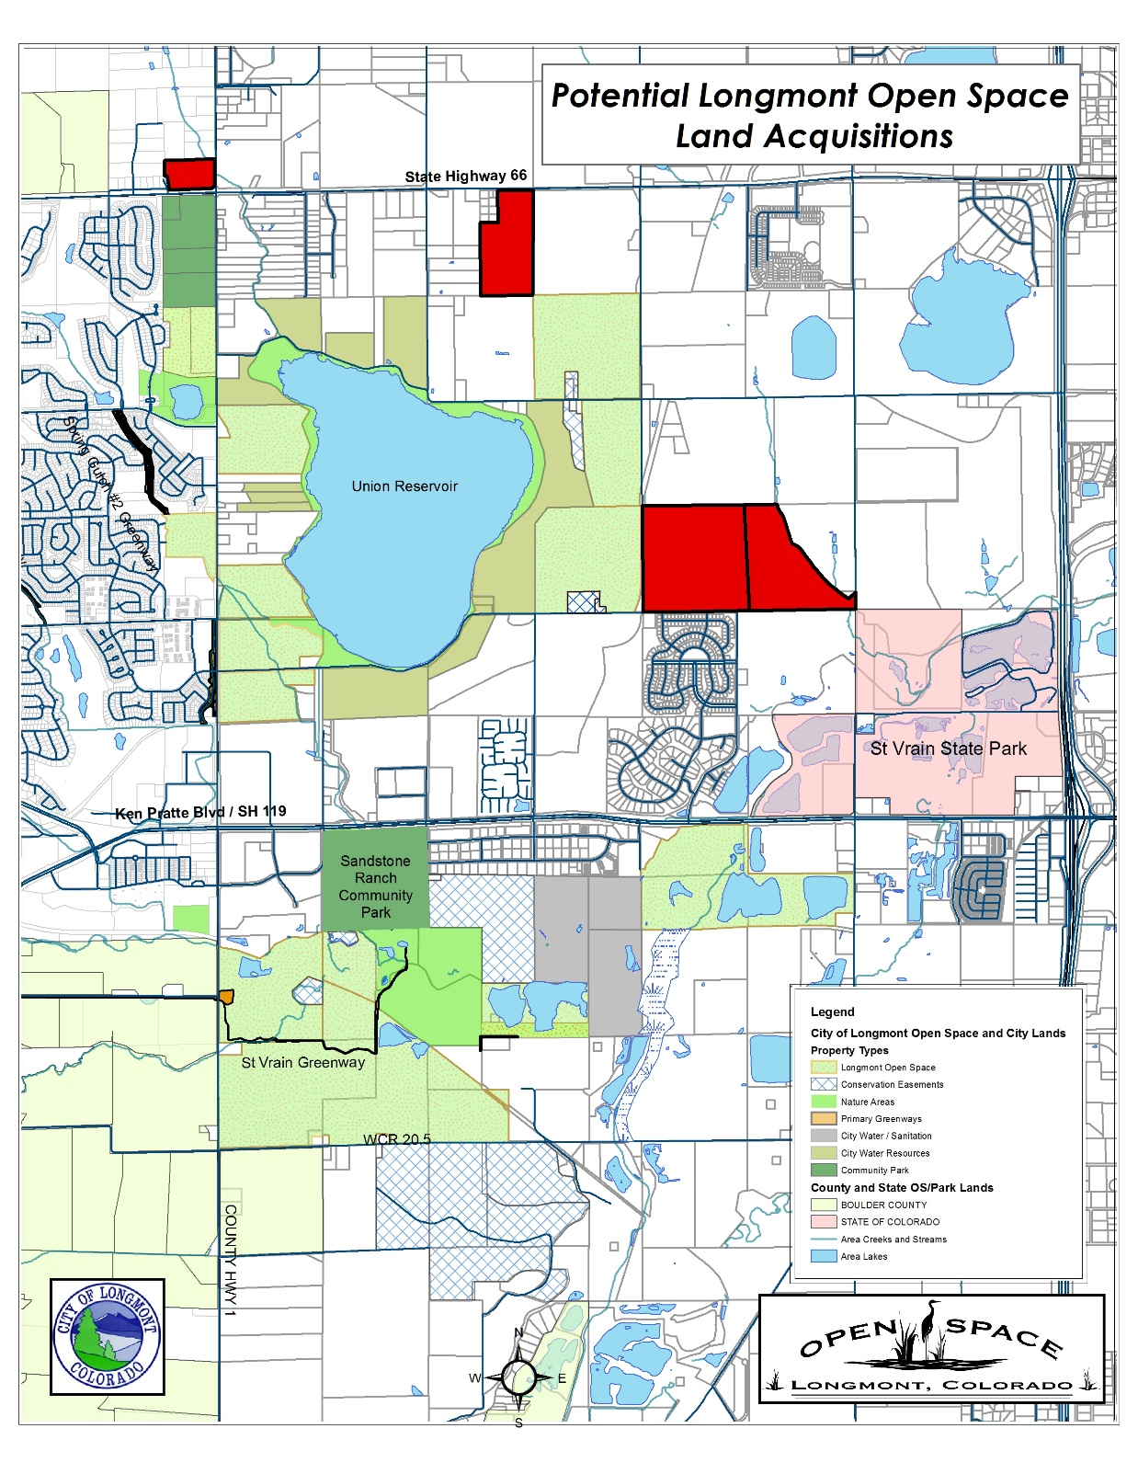
City of Longmont debt may be increased $22,000,000 with a repayment cost of $40,500,000, to acquire, improve and maintain open space for purposes identified in this ordinance.
Potential Longmont Open Space Acquisitions
Acquisitions total 343.9 acres
20.3 acres in Conservation Easements
323.6 acres in Fee
…expending $11.5 M, which will require additional bonding
Acquisitions represent a 12% acreage increase
Acquisitions will require issuance of additional debt of approximately $8.3

Slide 5
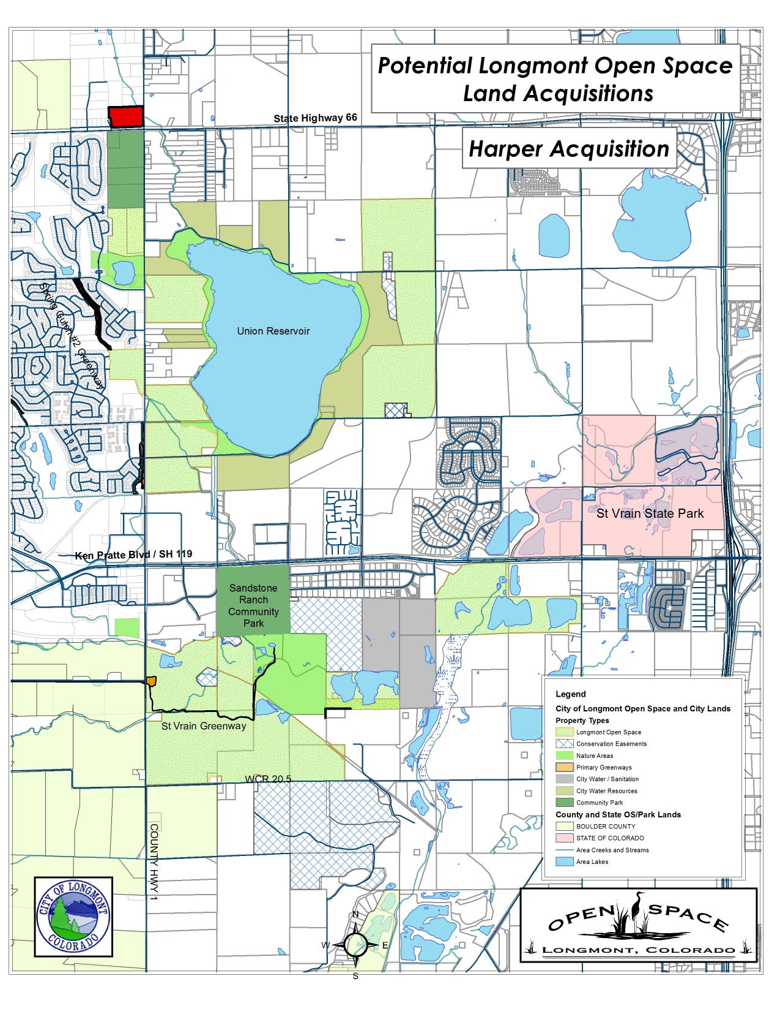
Potential Longmont Open Space Acquisitions
Harper
Acquisitions

Slide 6
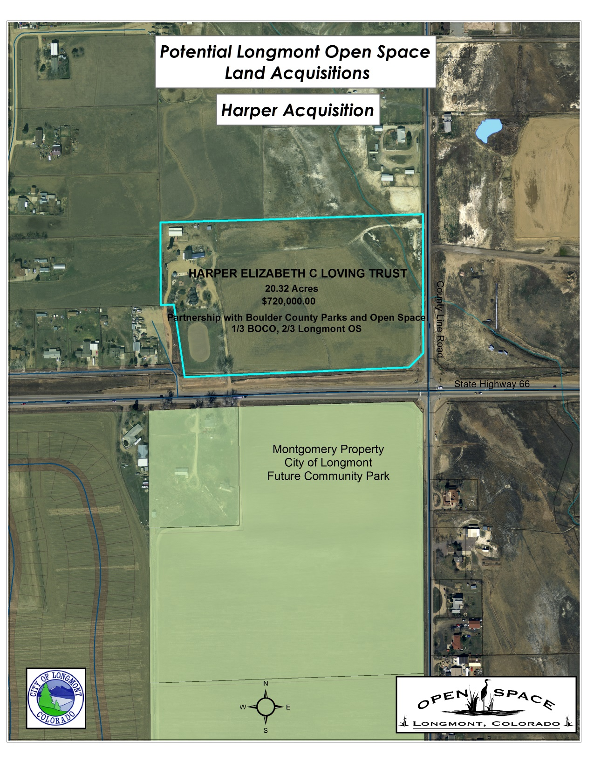
Potential Longmont Open Space Acquisitions
Open Space Criteria
Agricultural Preservation
Provide Urbans Shaping Buffer
Preserves Visual Corridor
Conserves Natural Resources
Harper
Acquisitions

Slide 7
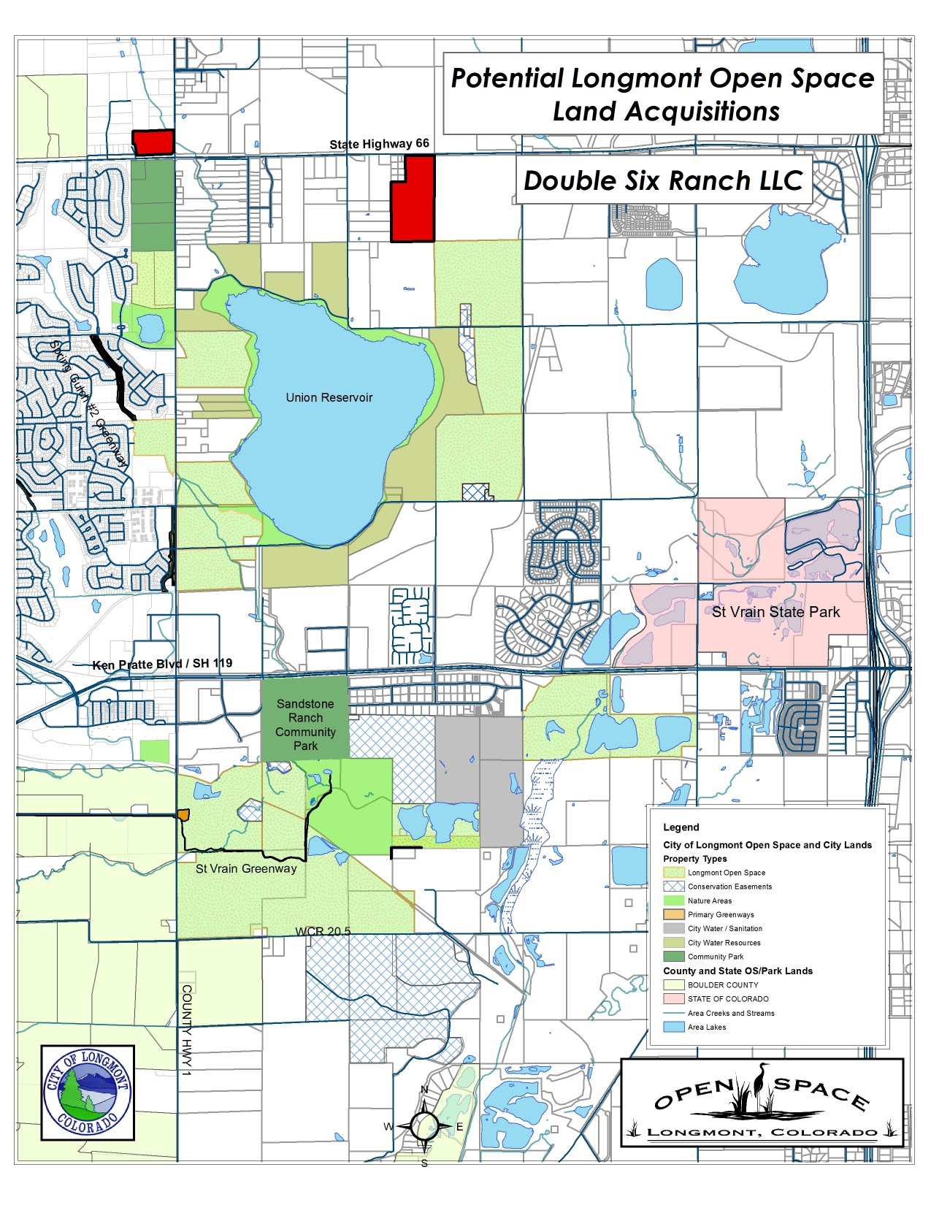
Potential Longmont Open Space Acquisitions
Double Six Ranch
Acquisitions

Slide 8
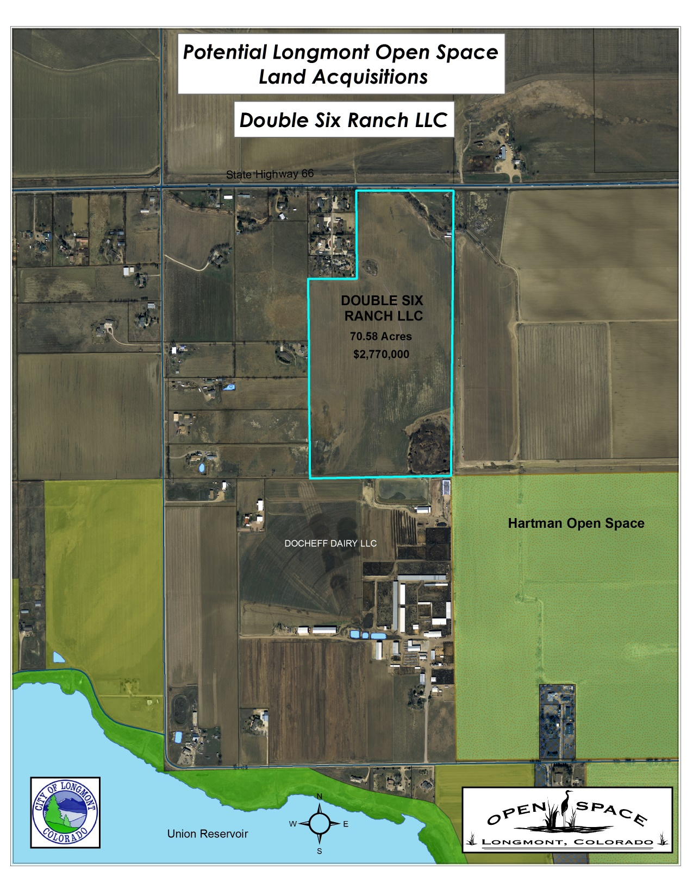
Potential Longmont Open Space Acquisitions
Open Space Criteria
Agricultural Preservation
Provide Urbans Shaping Buffer
Preserves Visual Corridor
Conserves Natural Resources
Double Six Ranch LLC
Acquisitions

Slide 9
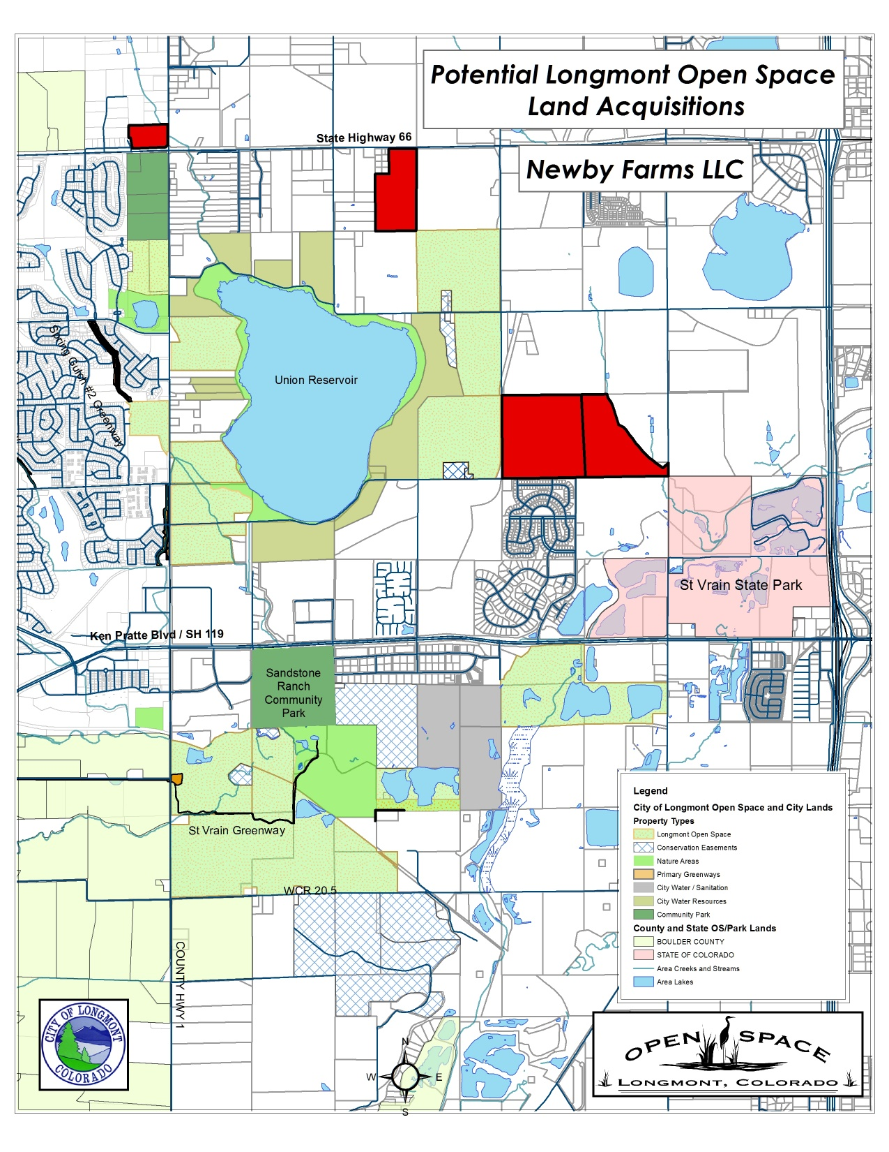
Potential Longmont Open Space Acquisitions
Newby Farms LLC
Acquisitions

Slide 10
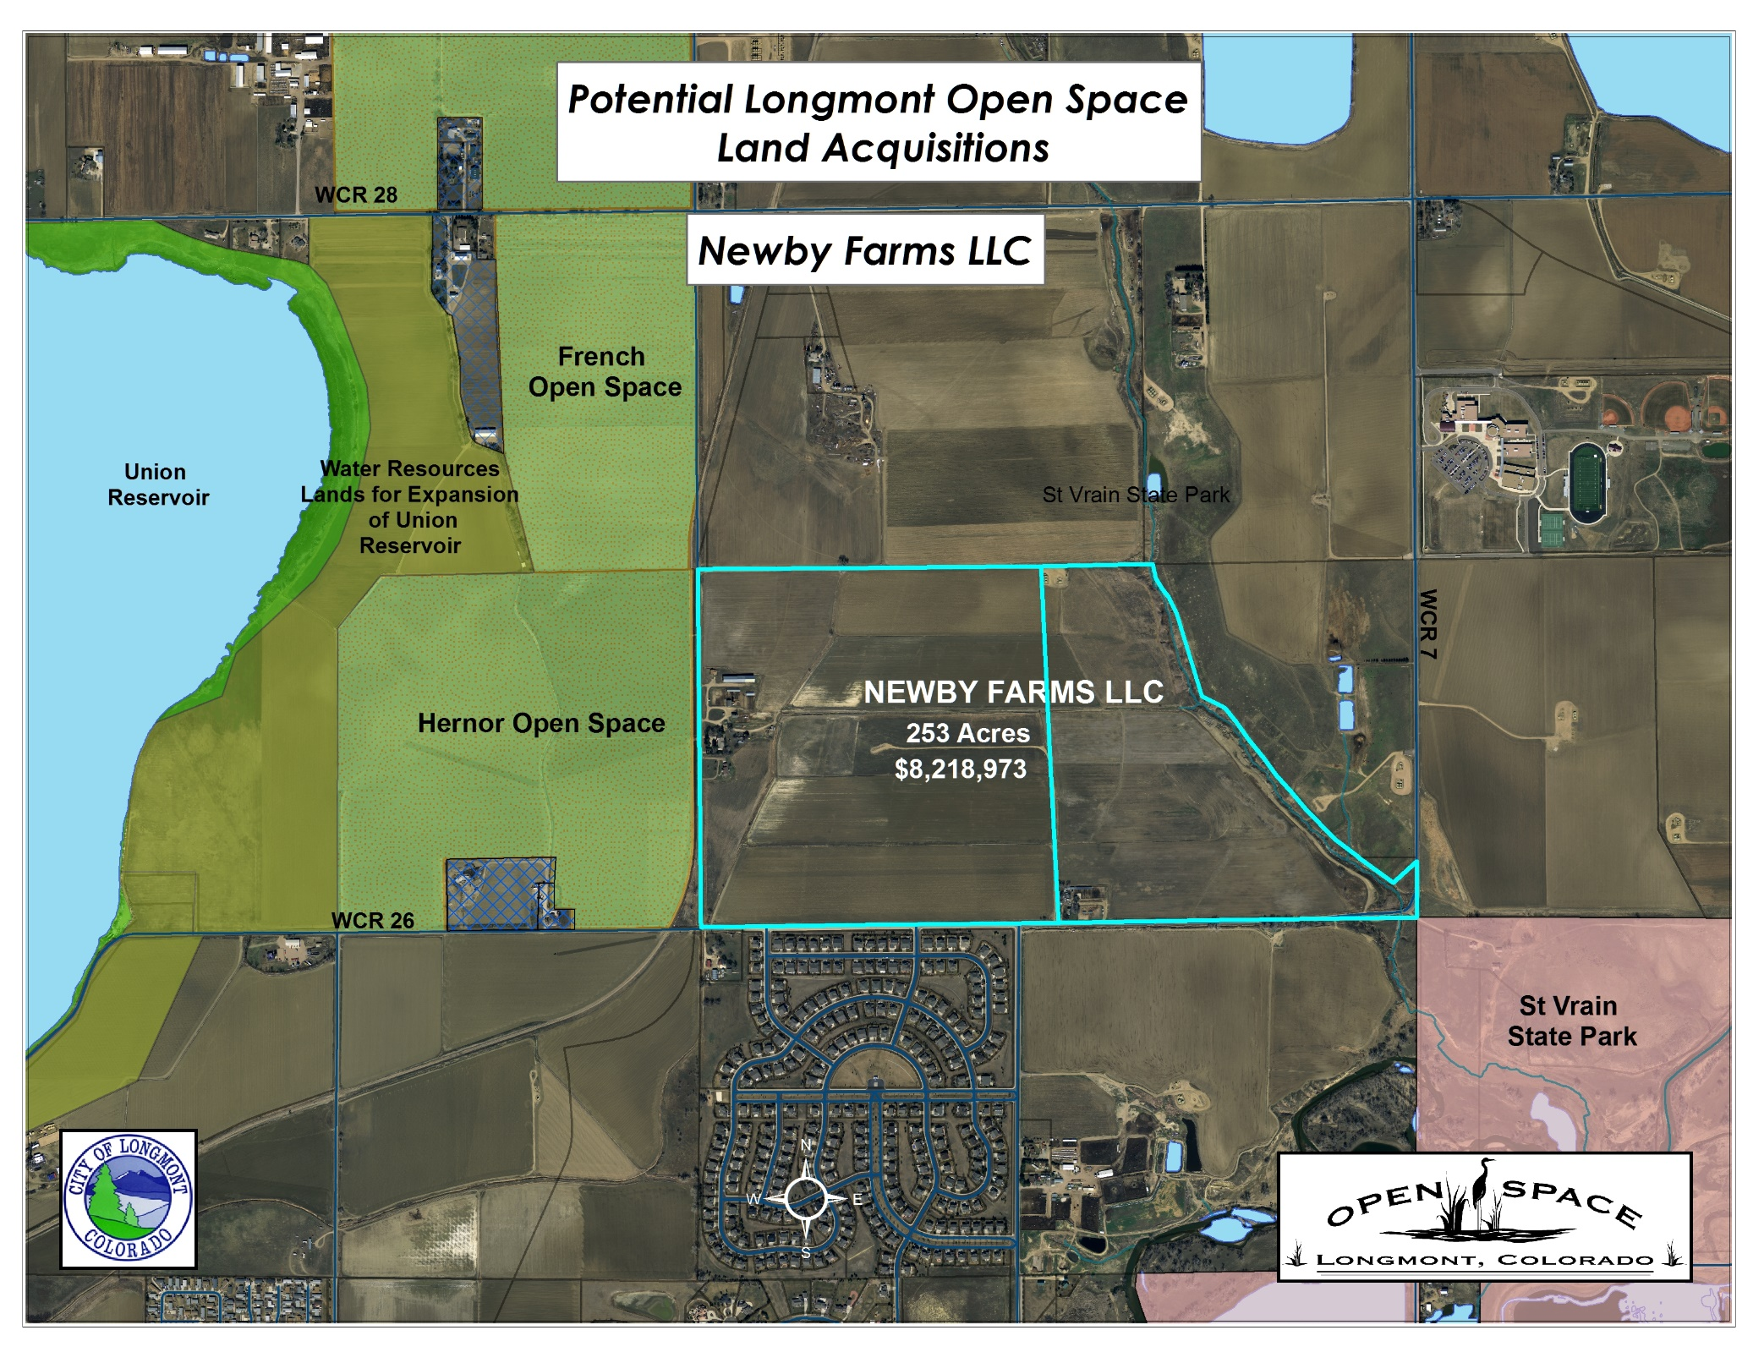
Potential Longmont Open Space Acquisitions
Open Space Criteria
Agricultural Preservation
Provide Urbans Shaping Buffer
Preserves Visual Corridor
Conserves Natural Resources
Trail Linkage between Union Reservoir and St Vrain State Park
Newby Farms LLC
Acquisitions

Slide 11
Open Space Criteria Matrix
Property Name | Acres | Cost | Water Acquired | Agriculture Preserve | Urban Shaping Buffer | Preserve Visual Corridor | Conserve Natural Resources | Trail Linkage
Harper | 20.32 (CE) | $480,000 | Yes | X | X | X | X
Double Six Ranch LLC | 70.58 (Fee) | $2,770,000 | Yes | X | X | X | X
Newby Farms LLC | 253 (Fee) | $8,218,973 | Yes | X | X | X | X | X
343.9 Acres
$11,468,973

Slide 12
Survey Results from the Open Space Master Plan (14.6% response rate)
revealed
Respondents provided a rating of 4.65 out of 5 to: The existence of Open Space, Nature Areas and trails is very important to respondents
51% identified needing more resources towards Open Space acquisition when accounting for future growth
74% of respondents would support a Open Space tax renewal
Respondents ranked the maintenance of the City existing Open Space as the top priority (40%) followed by acquiring new Open Space (32%) and finally developing amenities (29%)

Slide 13
Questions ?
Direction:
Regarding Land Negotiations
Issuance of Additional Debt

